Slide 1
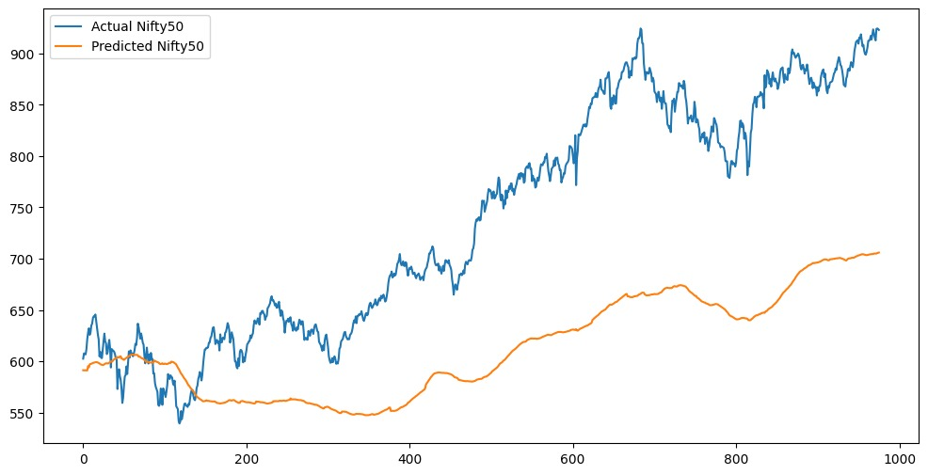
TKAN

Slide 2
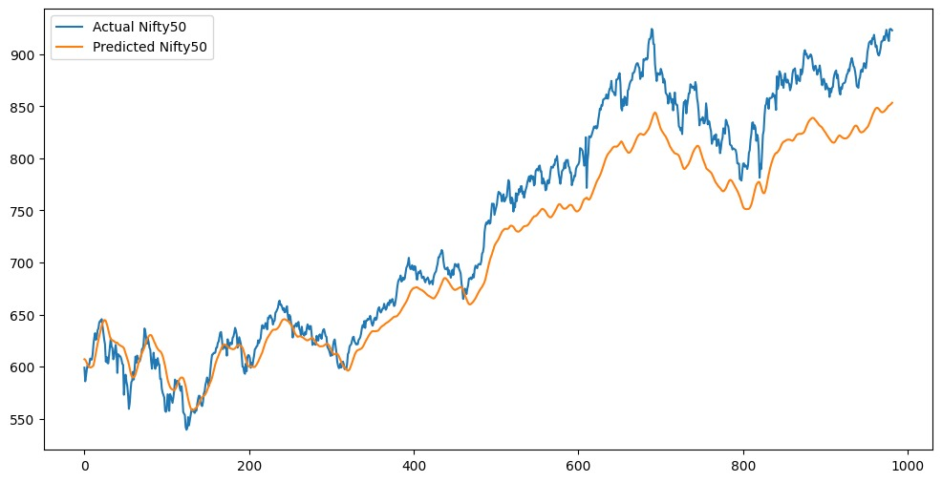
30 Day Window instead of 60

Slide 3
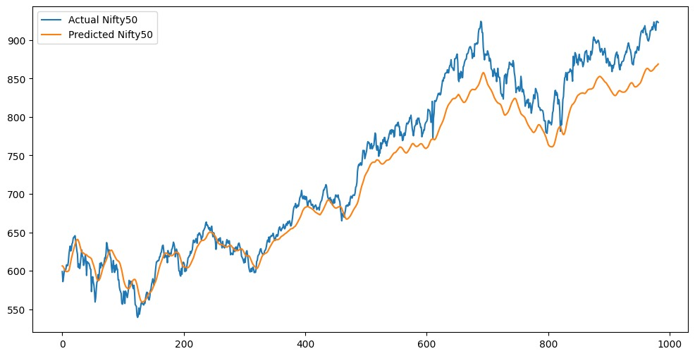
Adding Bias to Dense Layer

Slide 4
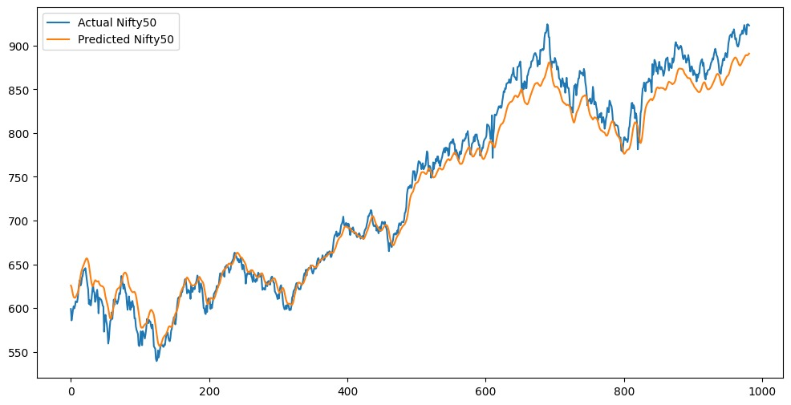
Batch size = 16 instead of 32

Slide 5
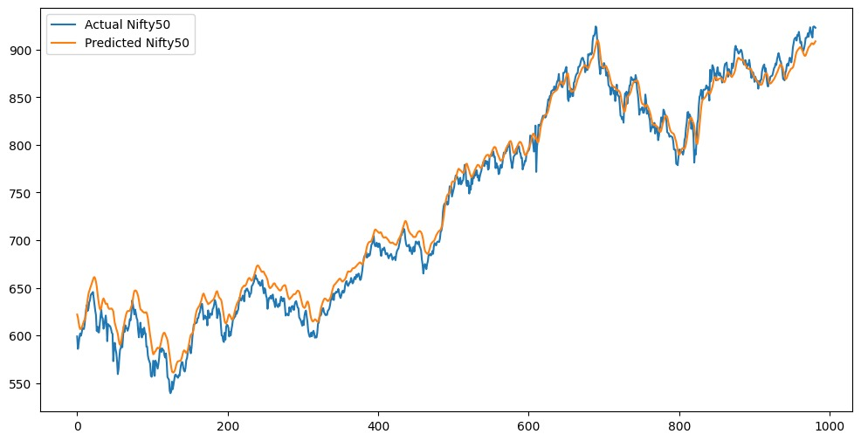
27 rounds instead of 20

Slide 6
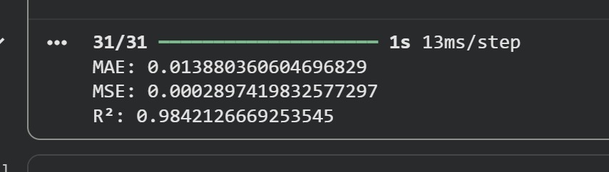
statistics

Slide 7
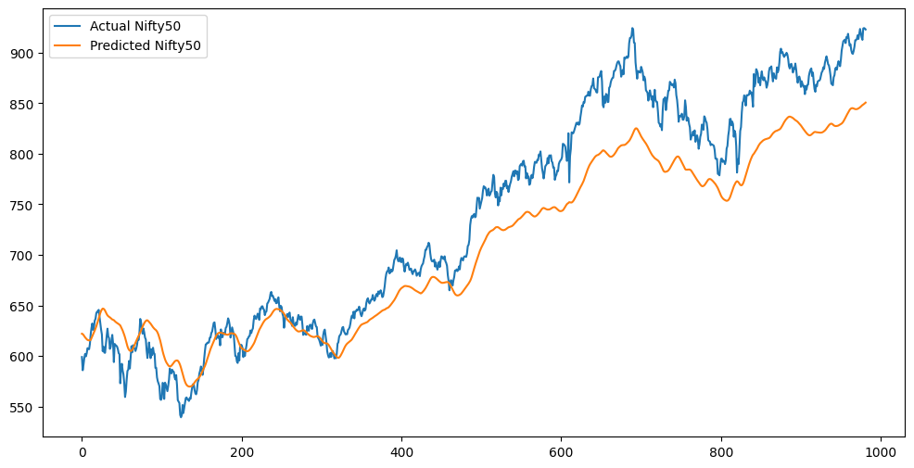
Batch size 32, seq len 30, two layers
MAE: 0.044407319379293944 MSE: 0.0028097508520577206 R²: 0.846903537901351

Slide 8
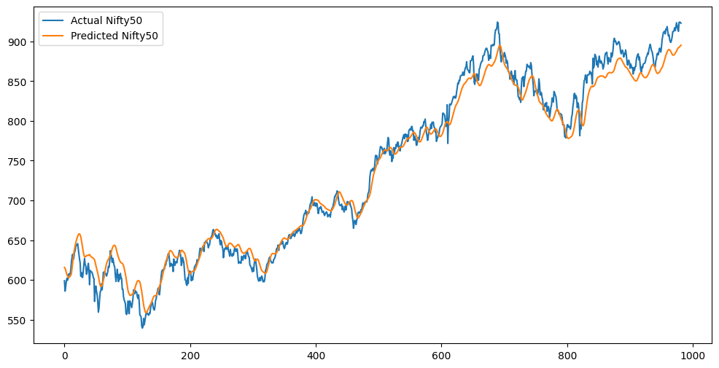
Batch size 16, seq len 30, two layers
MAE: 0.015715549909169246
MSE: 0.0004038140445238073
R²: 0.9779971588879257

Slide 9
Single Layer Results

Slide 10
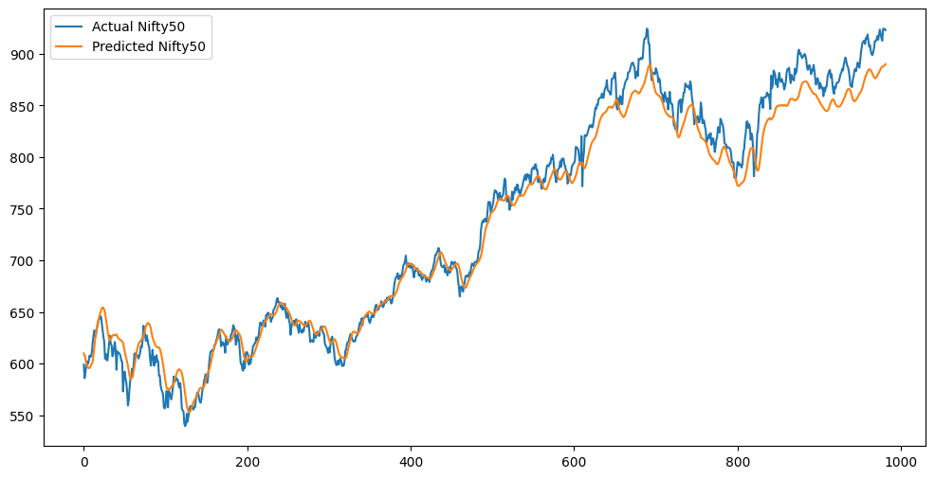
Batch size 8, seq len 30, two layers
MAE: 0.016776670585211
MSE: 0.00046143536970031106
R²: 0.9748575135989145

Slide 11
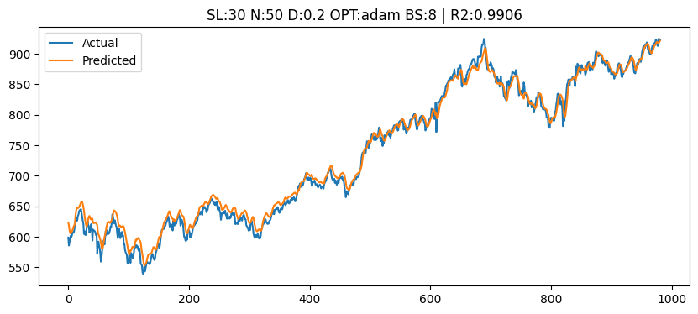

Slide 12
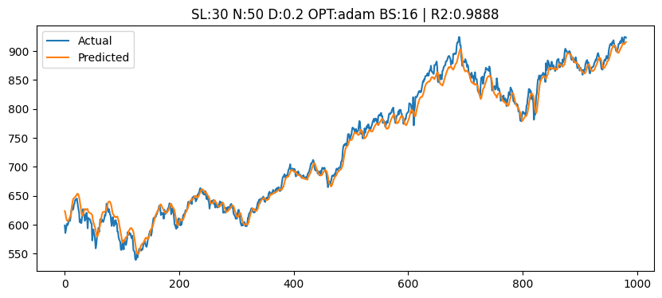

Slide 13
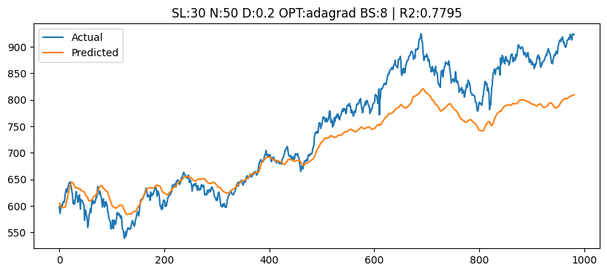

Slide 14
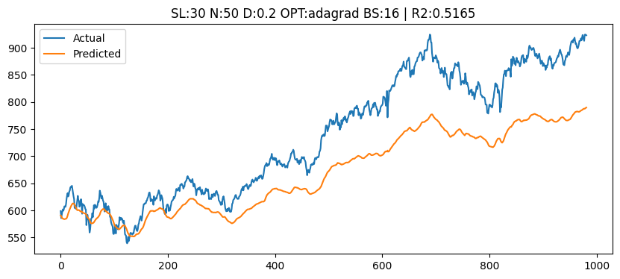

Slide 15
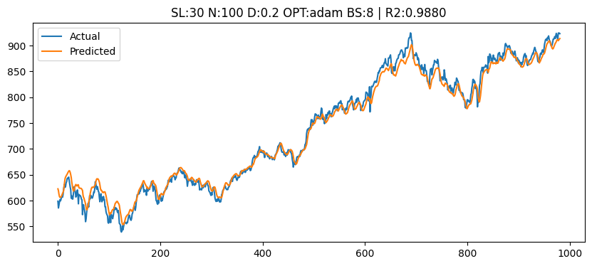

Slide 16
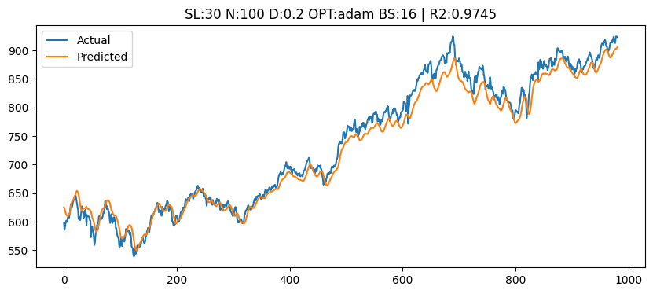

Slide 17
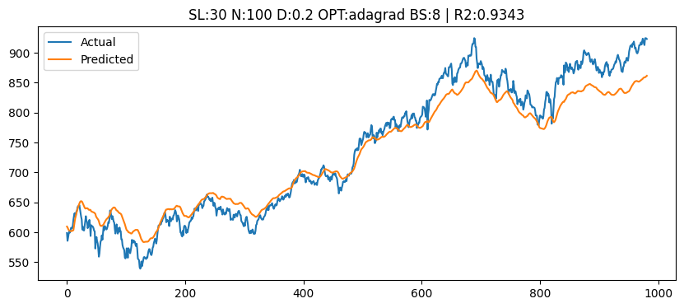

Slide 18
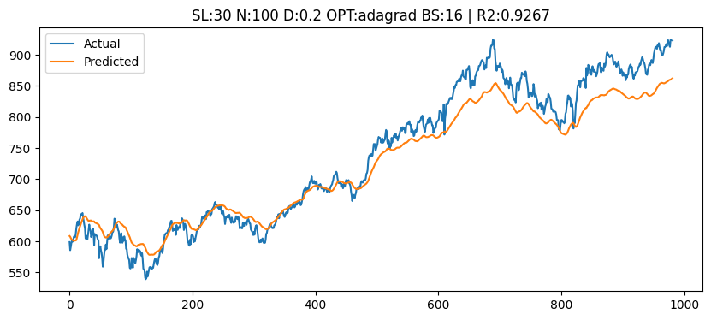

Slide 19
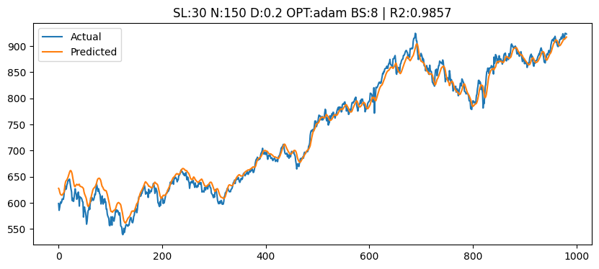

Slide 20
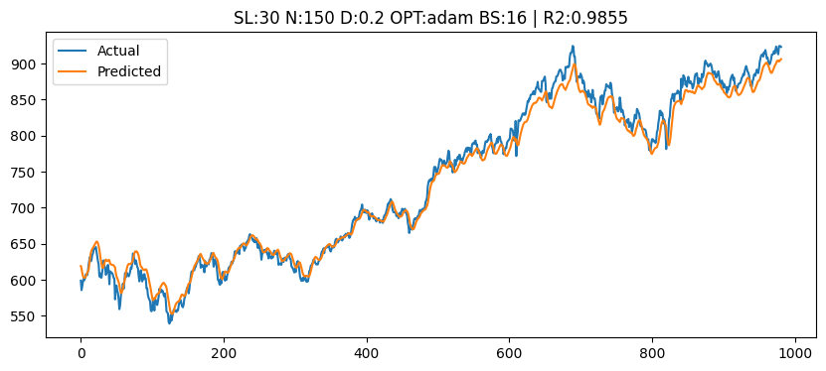

Slide 21
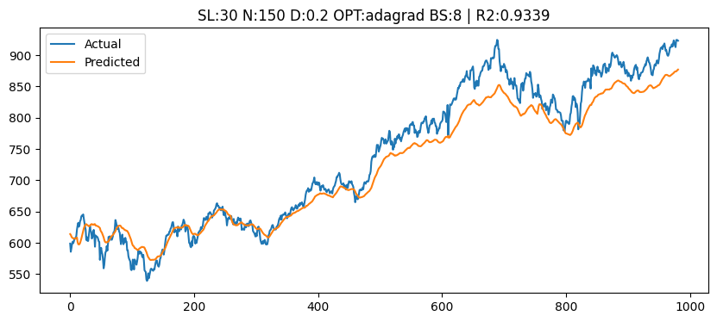

Slide 22
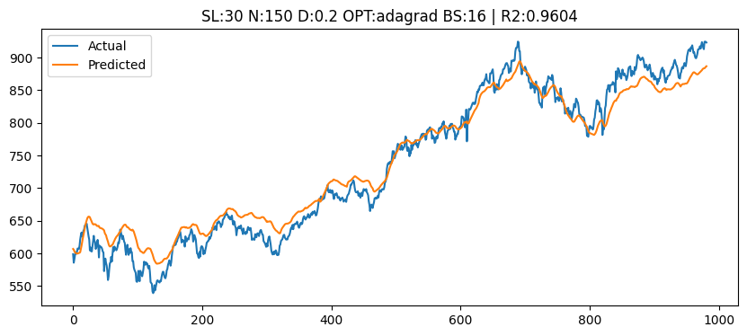

Slide 23
Nifty Index
 | SEQ_LENGTH | NEURONS | DROPOUT | OPTIMIZER | BATCH_SIZE | R2 | MAE
0 | 30 | 50 | 0.2 | adam | 8 | 0.990579 | 0.010324
1 | 30 | 50 | 0.2 | adam | 16 | 0.988821 | 0.011166
4 | 30 | 100 | 0.2 | adam | 8 | 0.988047 | 0.011553
8 | 30 | 150 | 0.2 | adam | 8 | 0.985728 | 0.012397
9 | 30 | 150 | 0.2 | adam | 16 | 0.985528 | 0.012855
5 | 30 | 100 | 0.2 | adam | 16 | 0.974497 | 0.017494
11 | 30 | 150 | 0.2 | adagrad | 16 | 0.960431 | 0.022438
6 | 30 | 100 | 0.2 | adagrad | 8 | 0.934256 | 0.028430
10 | 30 | 150 | 0.2 | adagrad | 8 | 0.933891 | 0.028515
7 | 30 | 100 | 0.2 | adagrad | 16 | 0.926662 | 0.029415
2 | 30 | 50 | 0.2 | adagrad | 8 | 0.779484 | 0.049591
3 | 30 | 50 | 0.2 | adagrad | 16 | 0.516468 | 0.081066

Slide 24
High ESG
 | SEQ_LENGTH | NEURONS | DROPOUT | OPTIMIZER | BATCH_SIZE | R2 | MAE
4 | 30 | 100 | 0.2 | adam | 8 | 0.991096 | 0.012492
0 | 30 | 50 | 0.2 | adam | 8 | 0.984324 | 0.017134
9 | 30 | 150 | 0.2 | adam | 16 | 0.983499 | 0.017592
5 | 30 | 100 | 0.2 | adam | 16 | 0.967340 | 0.025315
10 | 30 | 150 | 0.2 | adagrad | 8 | 0.967050 | 0.026691
8 | 30 | 150 | 0.2 | adam | 8 | 0.962538 | 0.028985
1 | 30 | 50 | 0.2 | adam | 16 | 0.942649 | 0.034342
6 | 30 | 100 | 0.2 | adagrad | 8 | 0.936984 | 0.035333
11 | 30 | 150 | 0.2 | adagrad | 16 | 0.920182 | 0.038445
7 | 30 | 100 | 0.2 | adagrad | 16 | 0.750962 | 0.068266
3 | 30 | 50 | 0.2 | adagrad | 16 | 0.731485 | 0.072417
2 | 30 | 50 | 0.2 | adagrad | 8 | 0.712384 | 0.076286

Slide 25
Low ESG
 | SEQ_LENGTH | NEURONS | DROPOUT | OPTIMIZER | BATCH_SIZE | R2 | MAE
9 | 30 | 150 | 0.2 | adam | 16 | 0.989858 | 0.011870
0 | 30 | 50 | 0.2 | adam | 8 | 0.985959 | 0.014080
4 | 30 | 100 | 0.2 | adam | 8 | 0.985848 | 0.014020
8 | 30 | 150 | 0.2 | adam | 8 | 0.981426 | 0.016256
5 | 30 | 100 | 0.2 | adam | 16 | 0.981401 | 0.016100
1 | 30 | 50 | 0.2 | adam | 16 | 0.973098 | 0.019768
10 | 30 | 150 | 0.2 | adagrad | 8 | 0.957474 | 0.025302
11 | 30 | 150 | 0.2 | adagrad | 16 | 0.946689 | 0.029196
7 | 30 | 100 | 0.2 | adagrad | 16 | 0.916395 | 0.036980
6 | 30 | 100 | 0.2 | adagrad | 8 | 0.913274 | 0.035634
2 | 30 | 50 | 0.2 | adagrad | 8 | 0.888083 | 0.040042
3 | 30 | 50 | 0.2 | adagrad | 16 | 0.800278 | 0.053035

Slide 26
High ESG Results

Slide 27
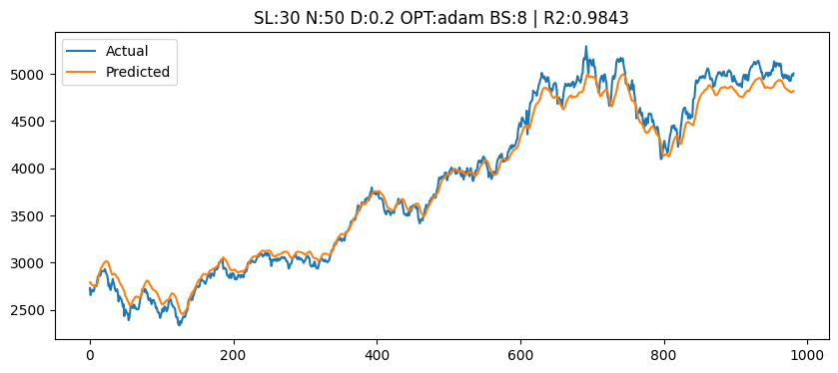

Slide 28
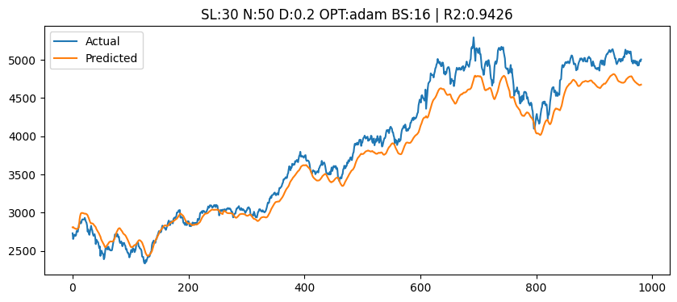

Slide 29
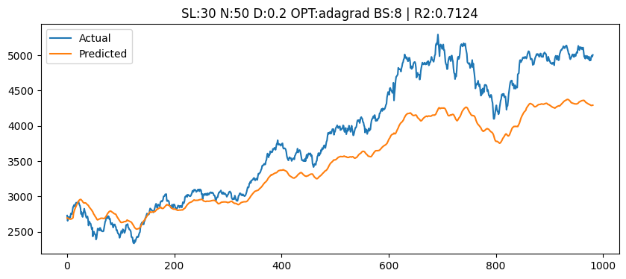

Slide 30
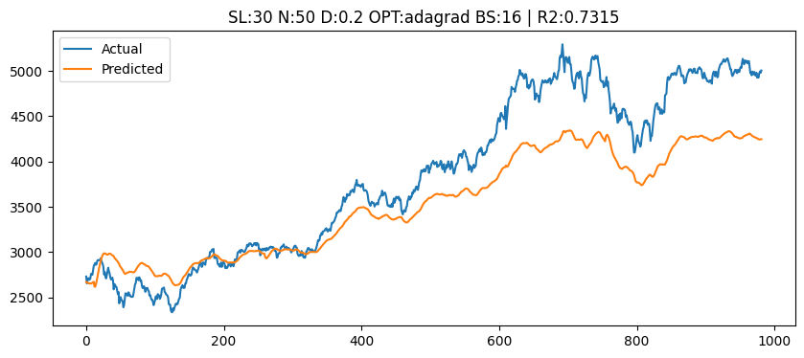

Slide 31
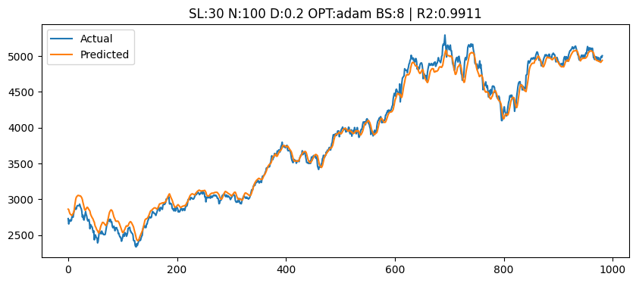

Slide 32
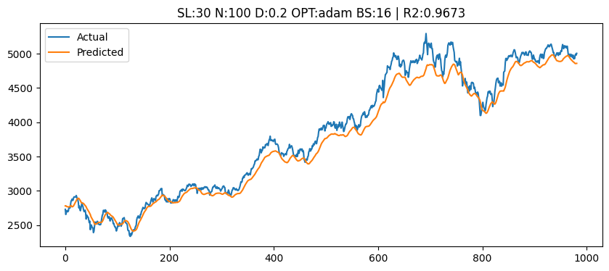

Slide 33
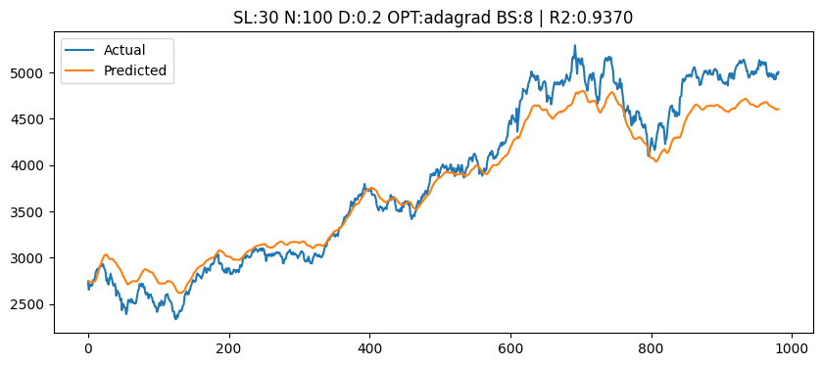

Slide 34


Slide 35
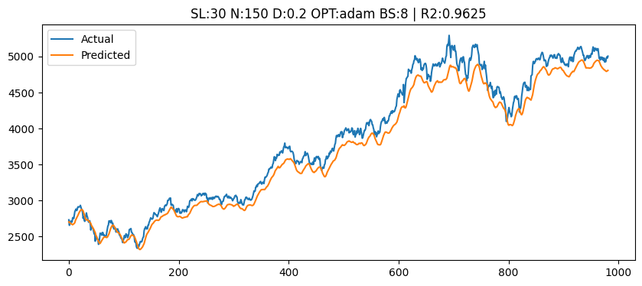

Slide 36
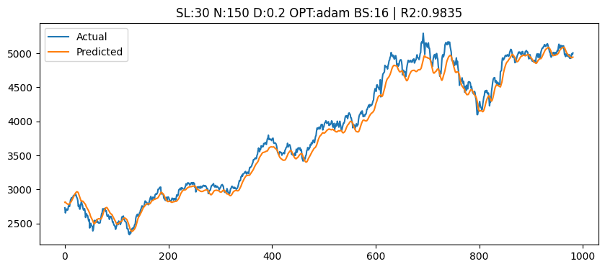

Slide 37
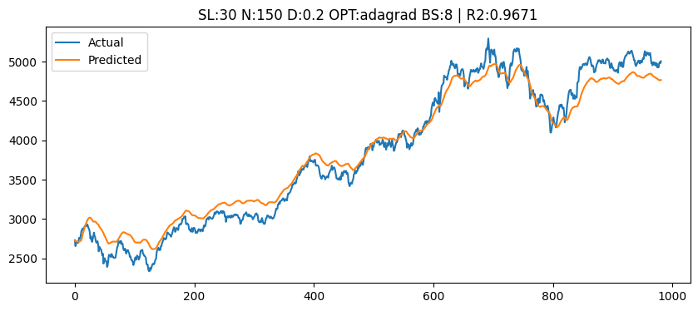

Slide 38
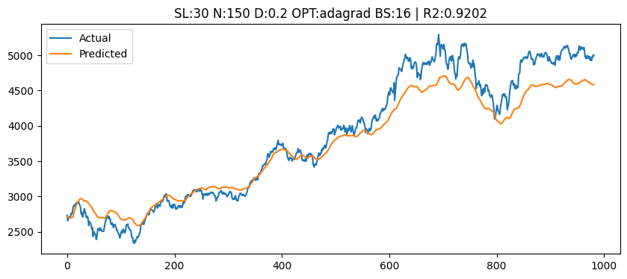

Slide 39
Low ESG Results

Slide 40
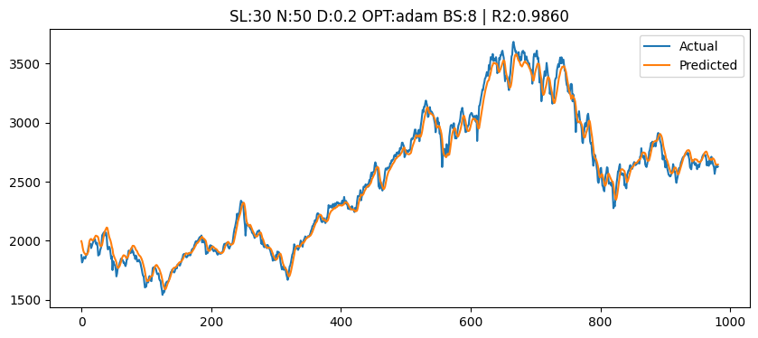

Slide 41
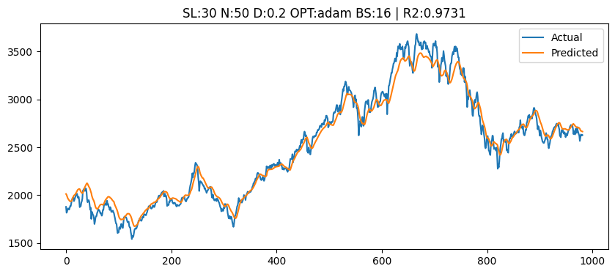

Slide 42
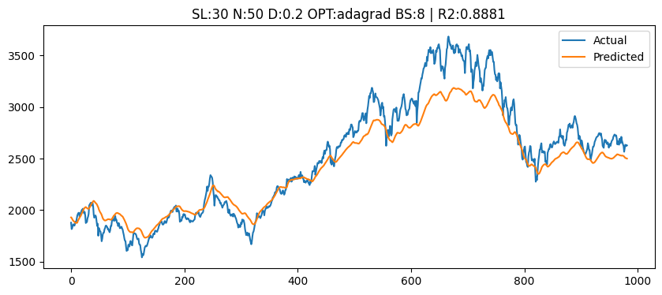

Slide 43
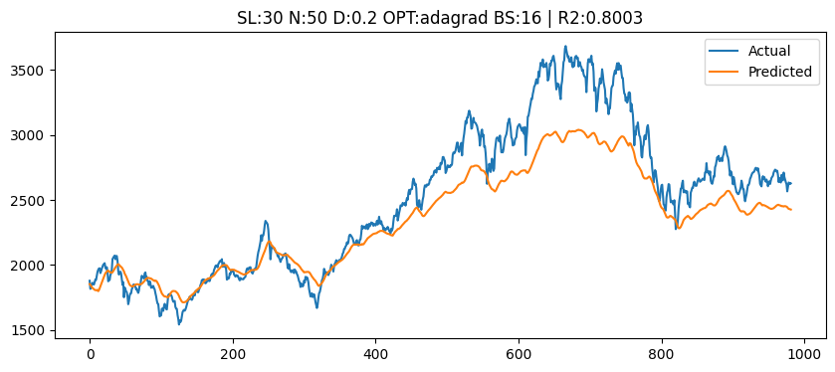

Slide 44


Slide 45
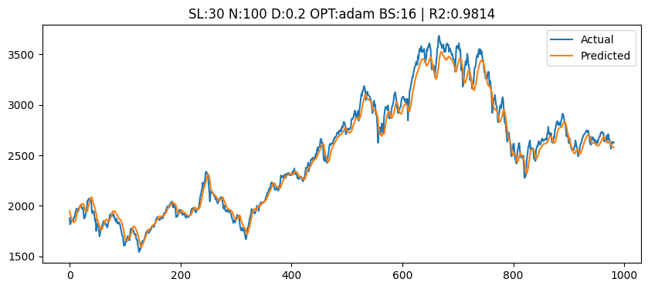

Slide 46
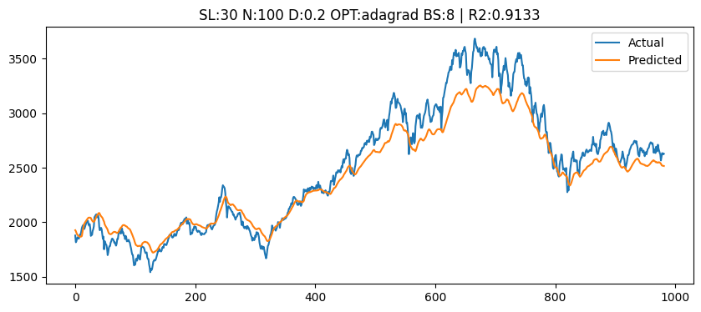

Slide 47
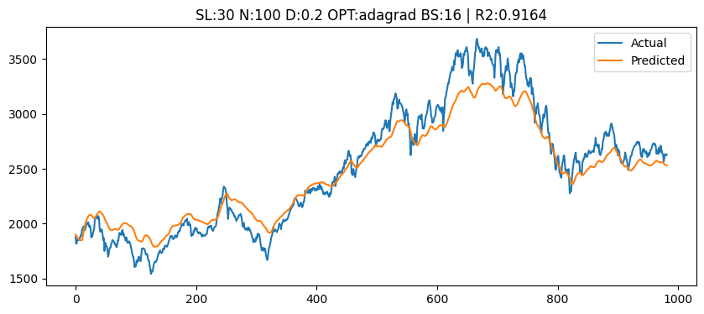

Slide 48
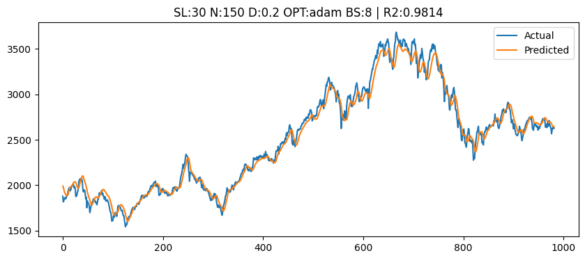

Slide 49
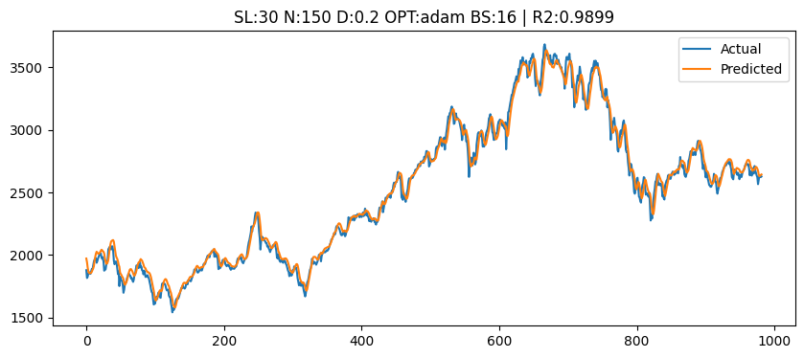

Slide 50
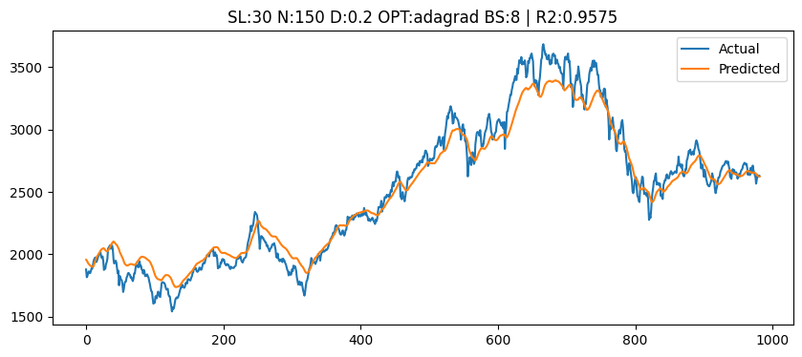

Slide 51
